Slide 1
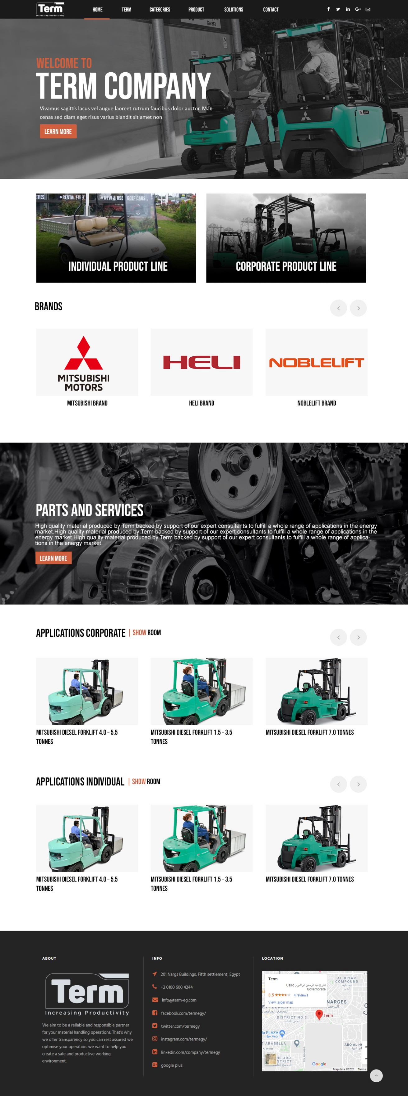



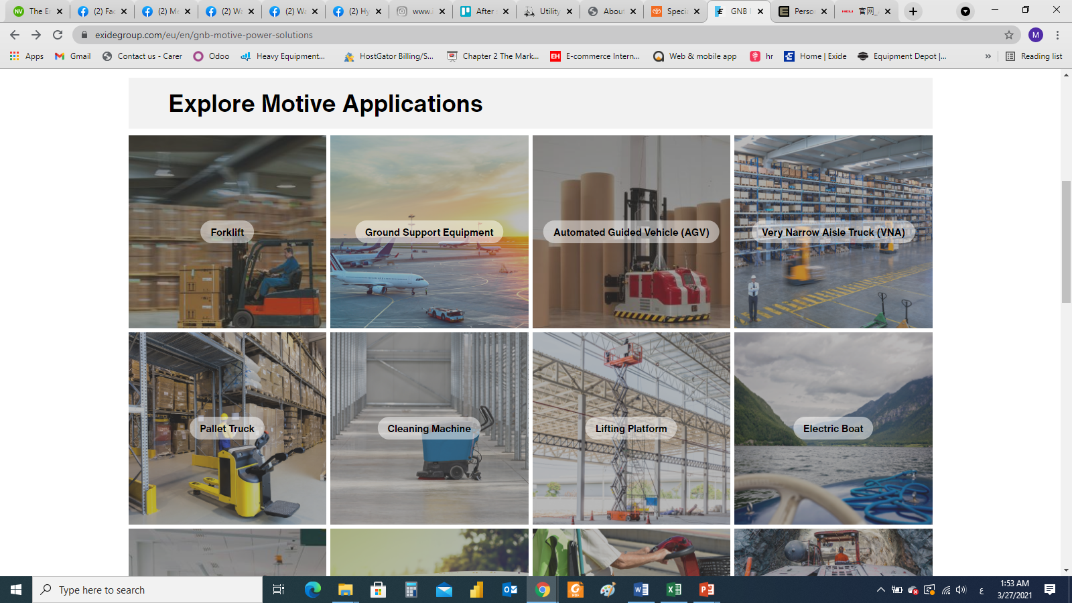
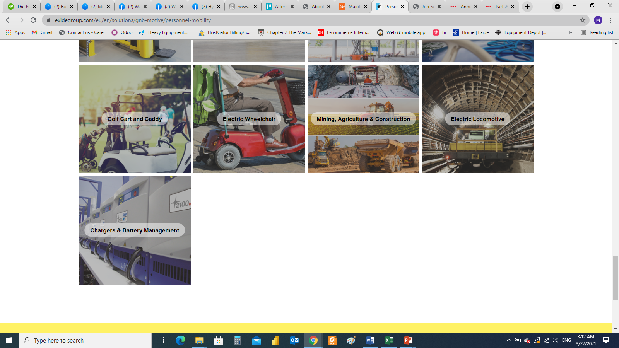
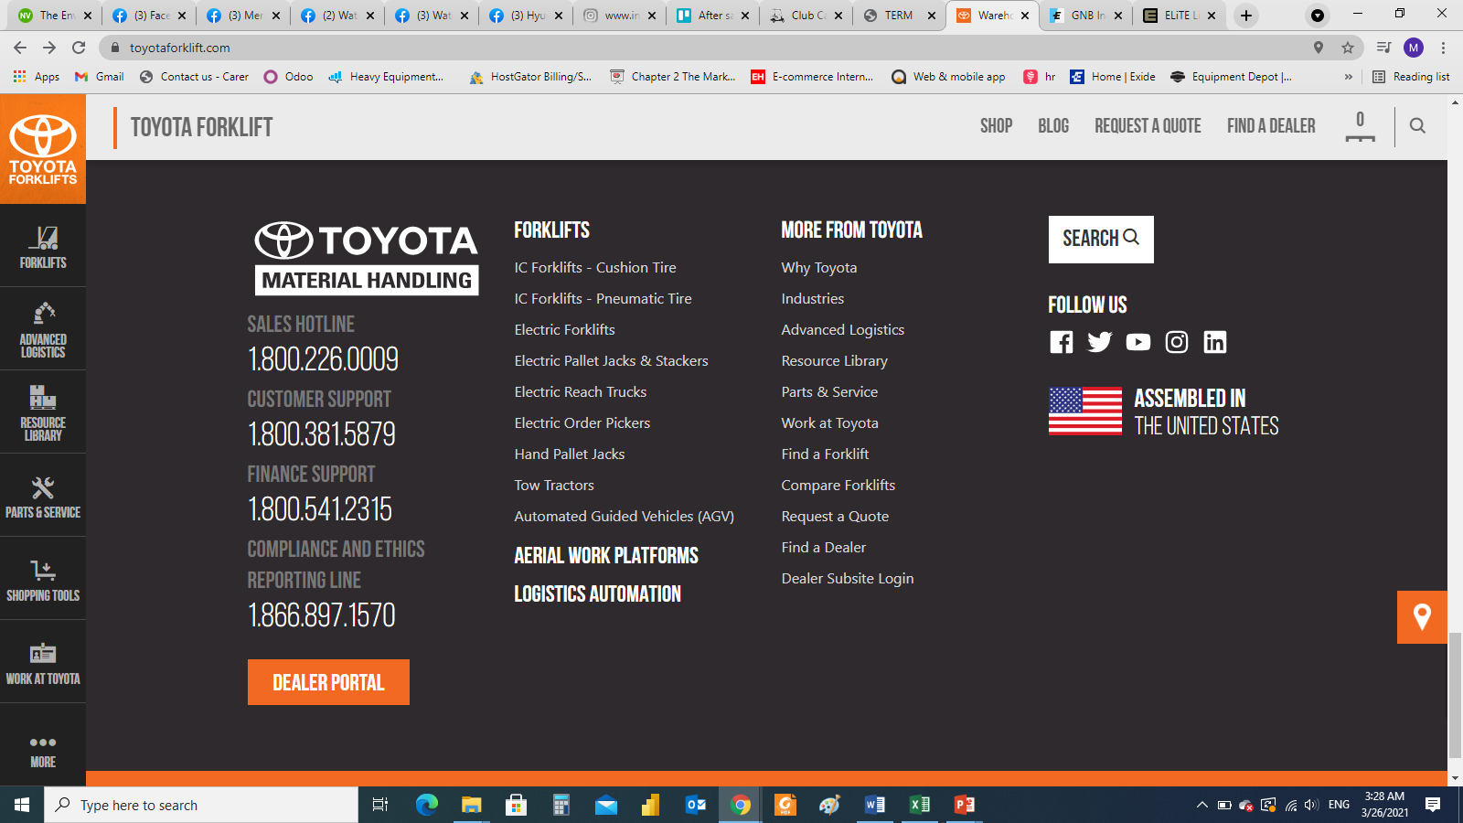


Links:
About
Products (Machinery – Personal) –
Parts and service –
Contact
Smaller font size same as Toyota website
Notes:
Forklift and material handling (Mitsubishi – Heli – Noblelift)
Electric vehicles (Citycart)
Power sports (Buggy – Segway)

Slide 2
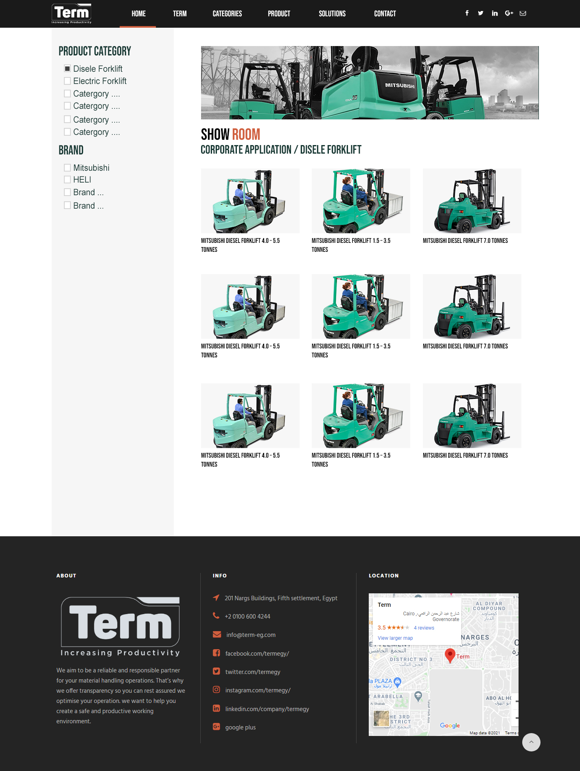
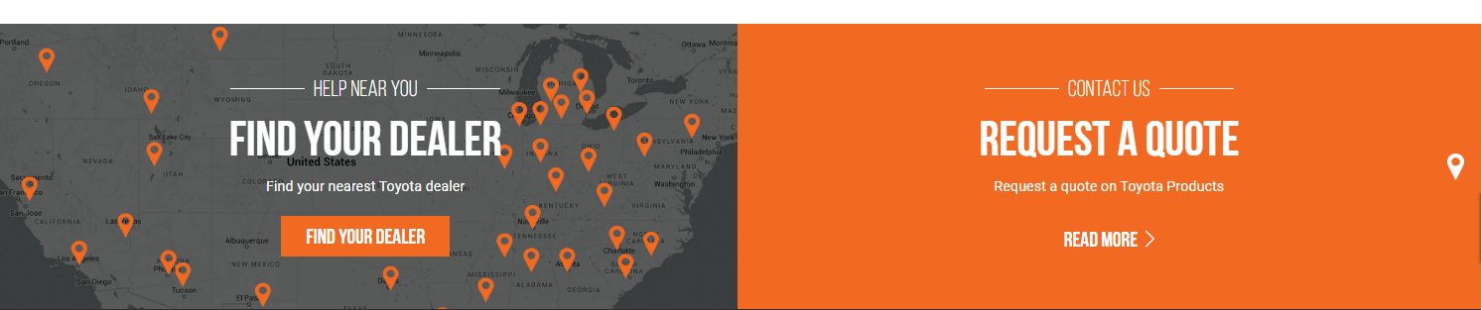
The second category changed based on first category
Example:
Brand: Heli
Category: Diesel forklift
Sub category: 3 ton – 5 ton – 10 ton.
Brand: CITYCART
Category: Electric bus
Sub category: 14 seater
Add extra category based on industry (IF POSSIBLE)
Example : Retail , Hotels, factory,
When user selecting Mitsubishi but not select category
The page will display all products of Mitsubishi (but) classified by category ( all diesel forklift then all electric forklift with head title )
Electric Forklift
Notes:
Forklift and material handling (Mitsubishi – Heli – Noblelift)
Electric vehicles (Citycart)
Power sports (Buggy – Segway)

Slide 3
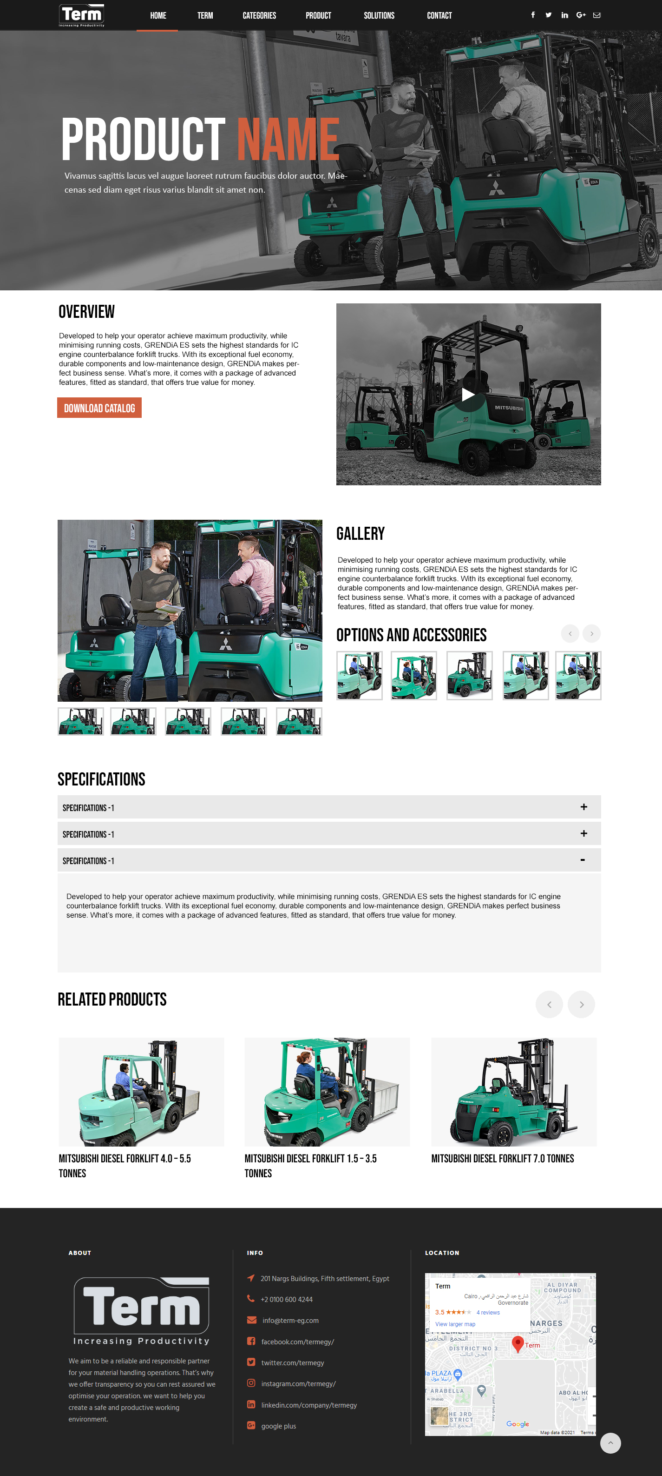
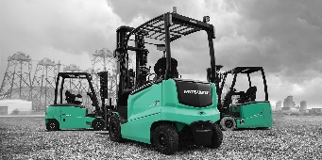
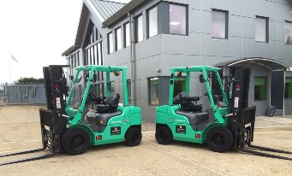
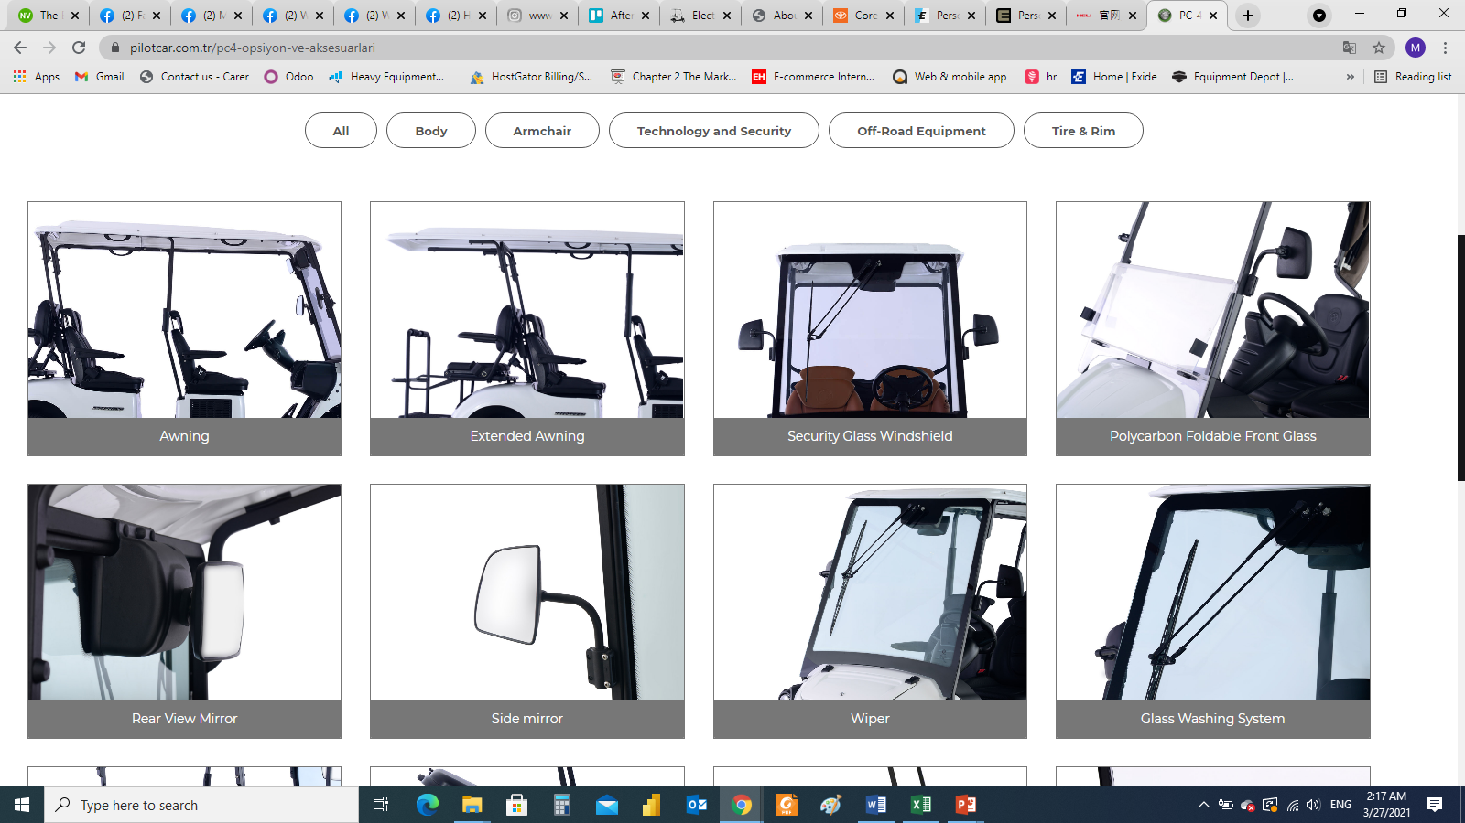
TABLE
https://www.clubcar.com/en/personal/golf-new/onward-4-passenger
FEATURES
Notes:
Forklift and material handling (Mitsubishi – Heli – Noblelift)
Electric vehicles (Citycart)
Power sports (Buggy – Segway)

Slide 4
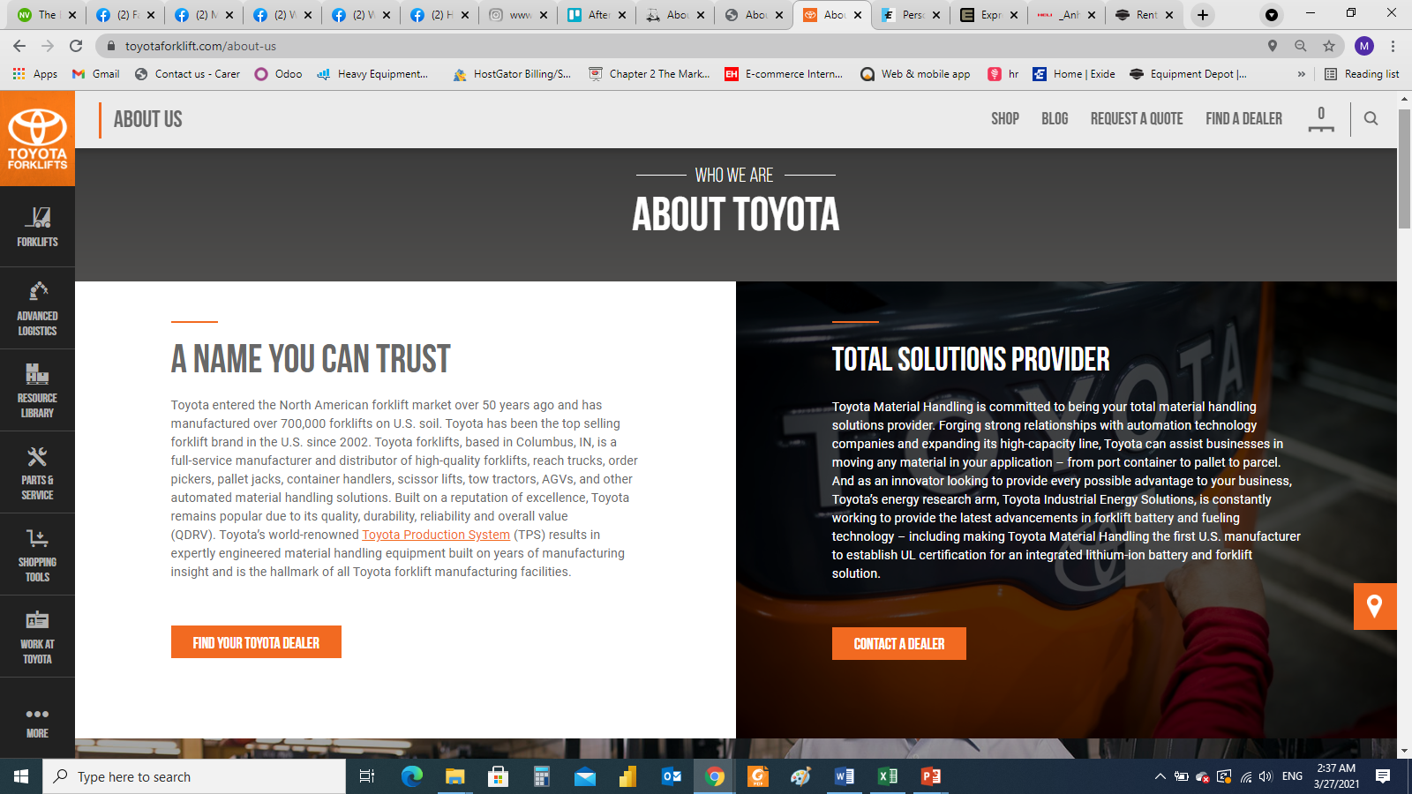
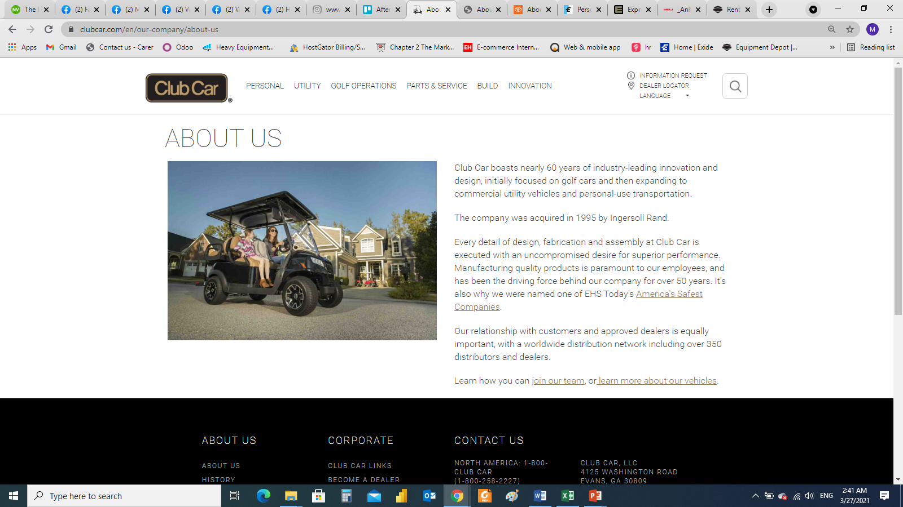
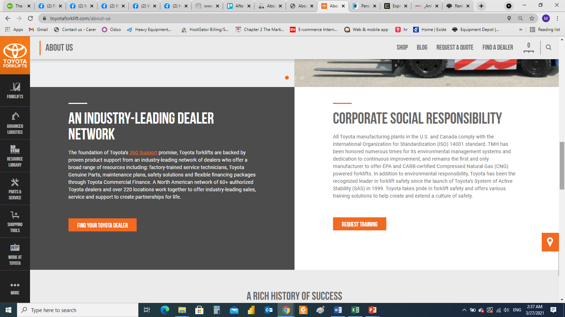
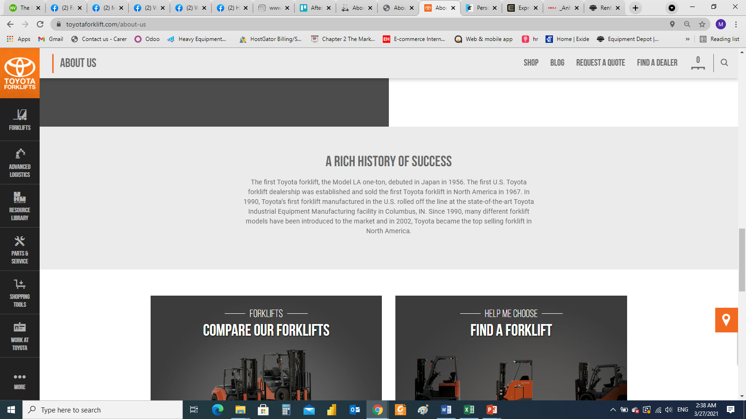
ABOUT
https://www.toyotaforklift.com/about-us
SLIDER
Notes:
Forklift and material handling (Mitsubishi – Heli – Noblelift)
Electric vehicles (Citycart)
Power sports (Buggy – Segway)

Slide 5
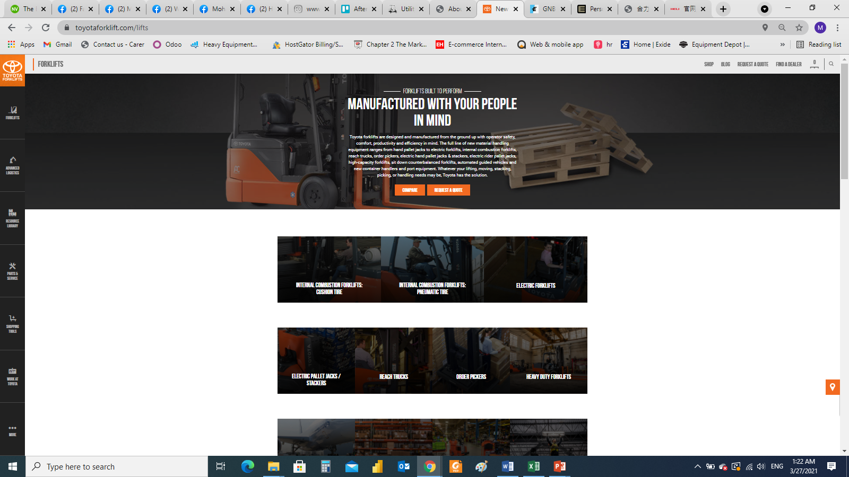
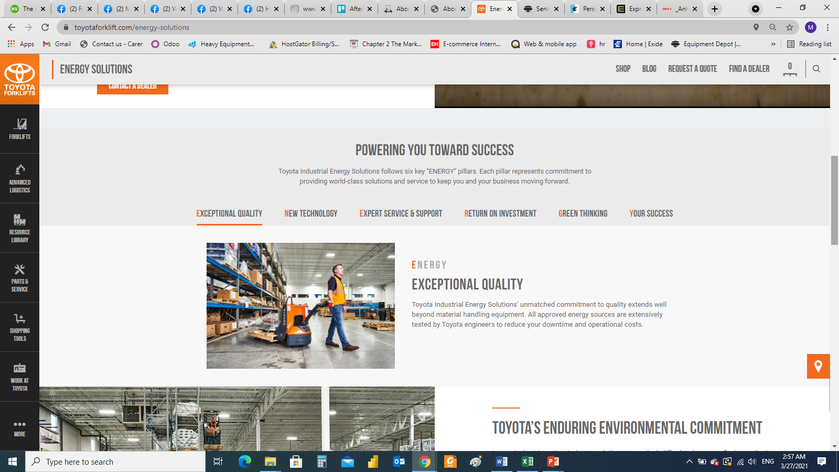
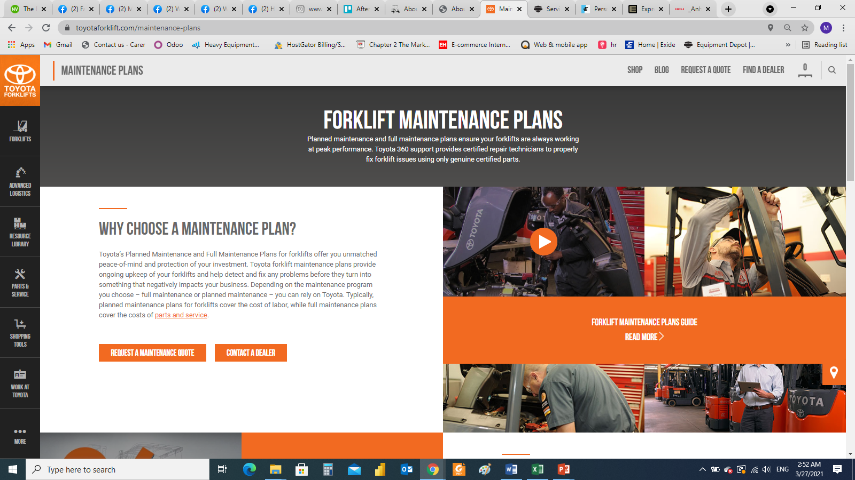
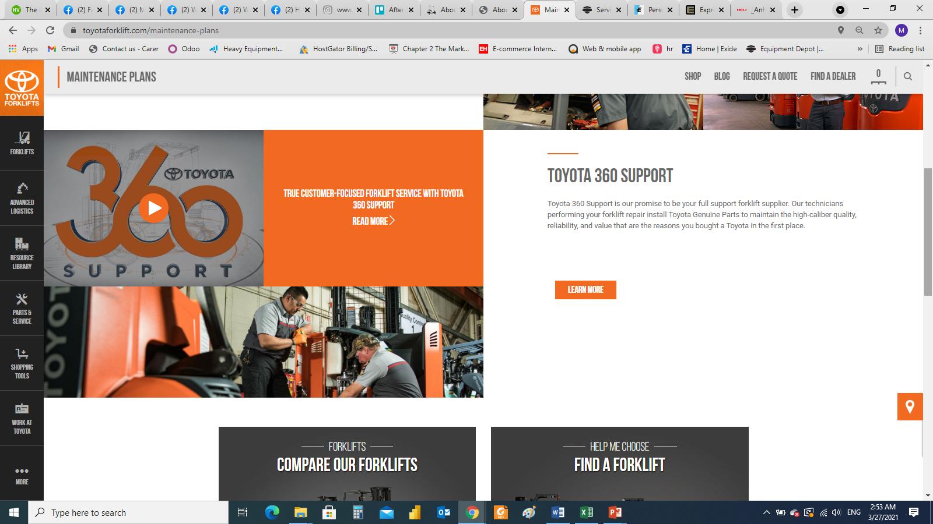
Request a consultation / Parts / Maintenance / other enquires
https://www.toyotaforklift.com/energy-solutions
https://www.toyotaforklift.com/maintenance-plans
Notes:
Forklift and material handling (Mitsubishi – Heli – Noblelift)
Electric vehicles (Citycart)
Power sports (Buggy – Segway)

Slide 6
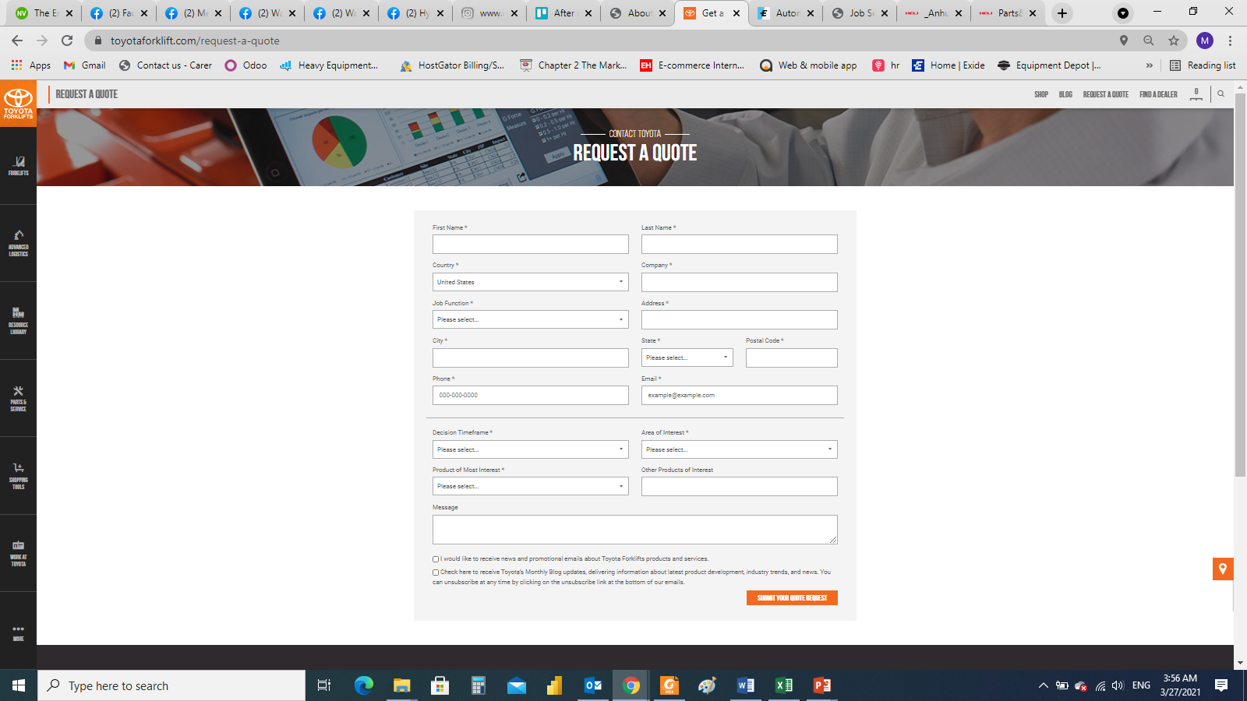
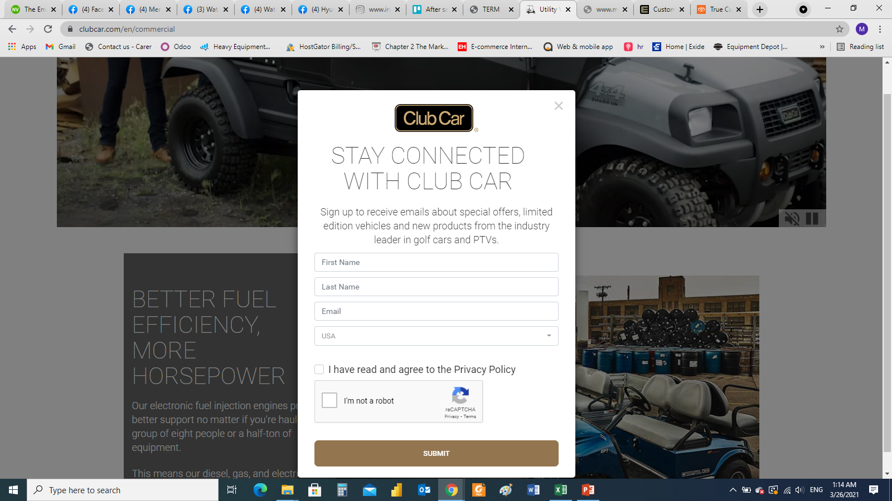
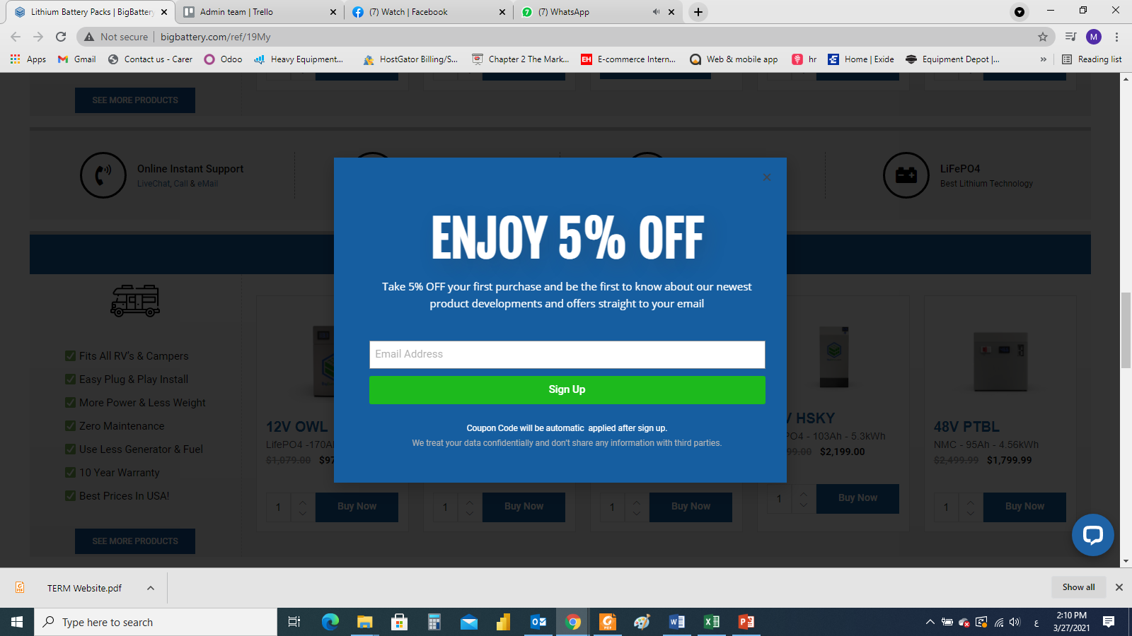
More pages on website
https://www.toyotaforklift.com/request-a-quote
Request a quotation
Add pop ups
Notes:
Forklift and material handling (Mitsubishi – Heli – Noblelift)
Electric vehicles (Citycart)
Power sports (Buggy – Segway)

Slide 7
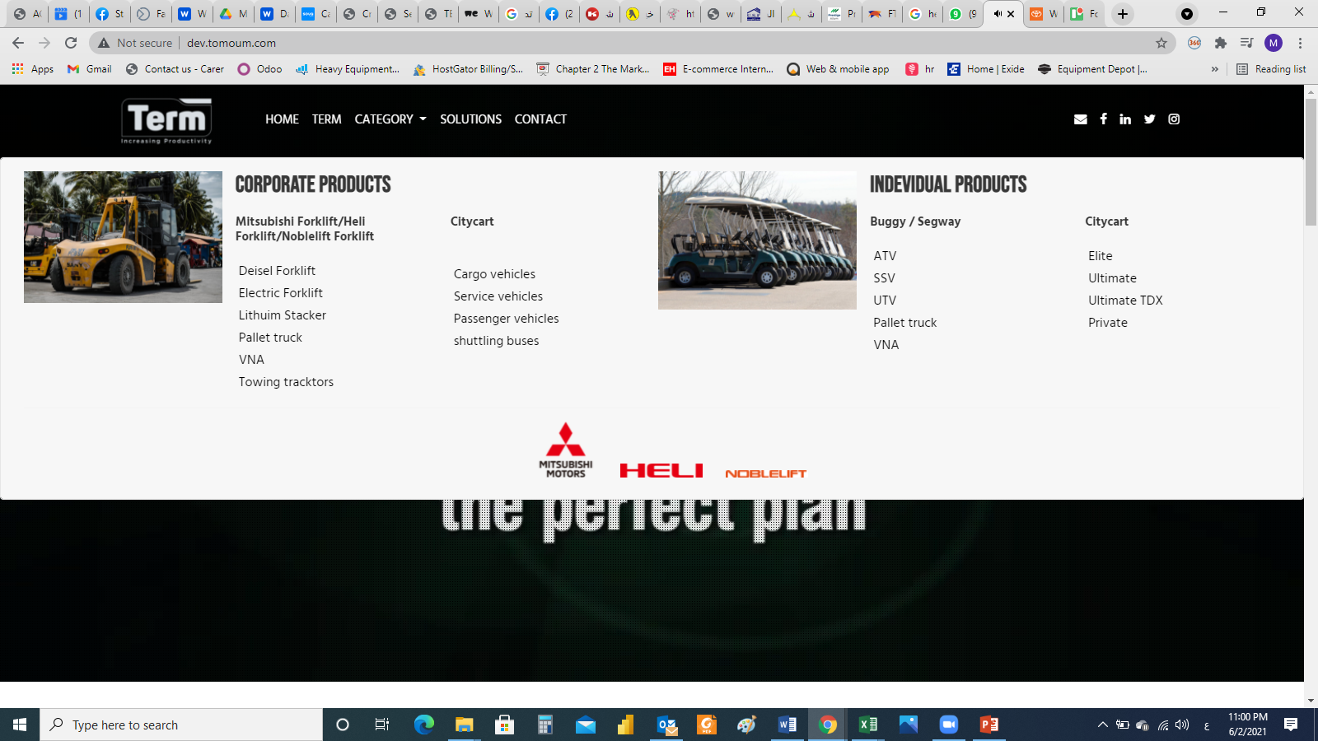
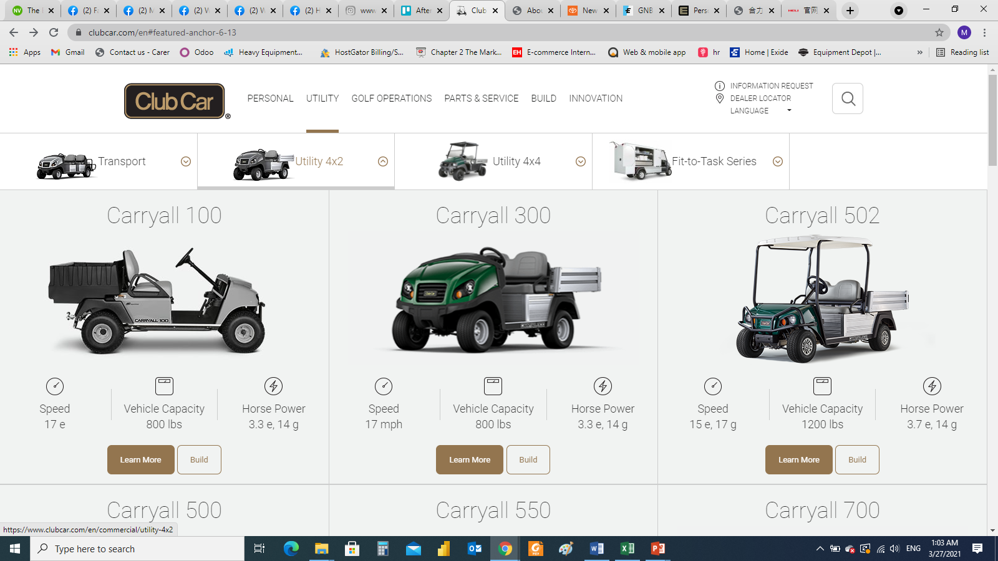
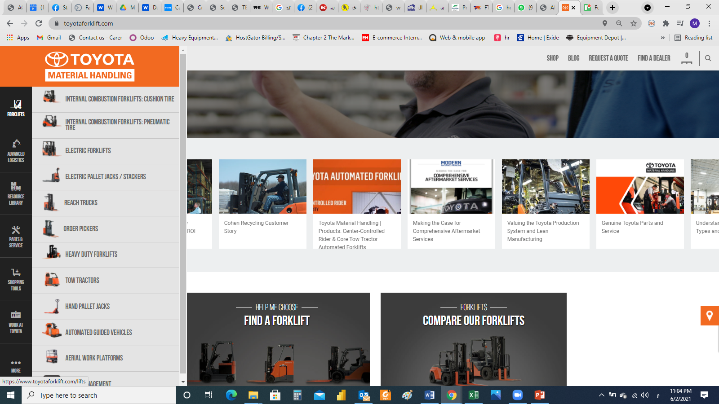
Mega menu
الفكرة التى تم الحديث عنها فى التليفون و هى وضع صورة لكل بند:
مثال 1
مثال 2
Notes:
Forklift and material handling (Mitsubishi – Heli – Noblelift)
Electric vehicles (Citycart)
Power sports (Buggy – Segway)

Slide 8
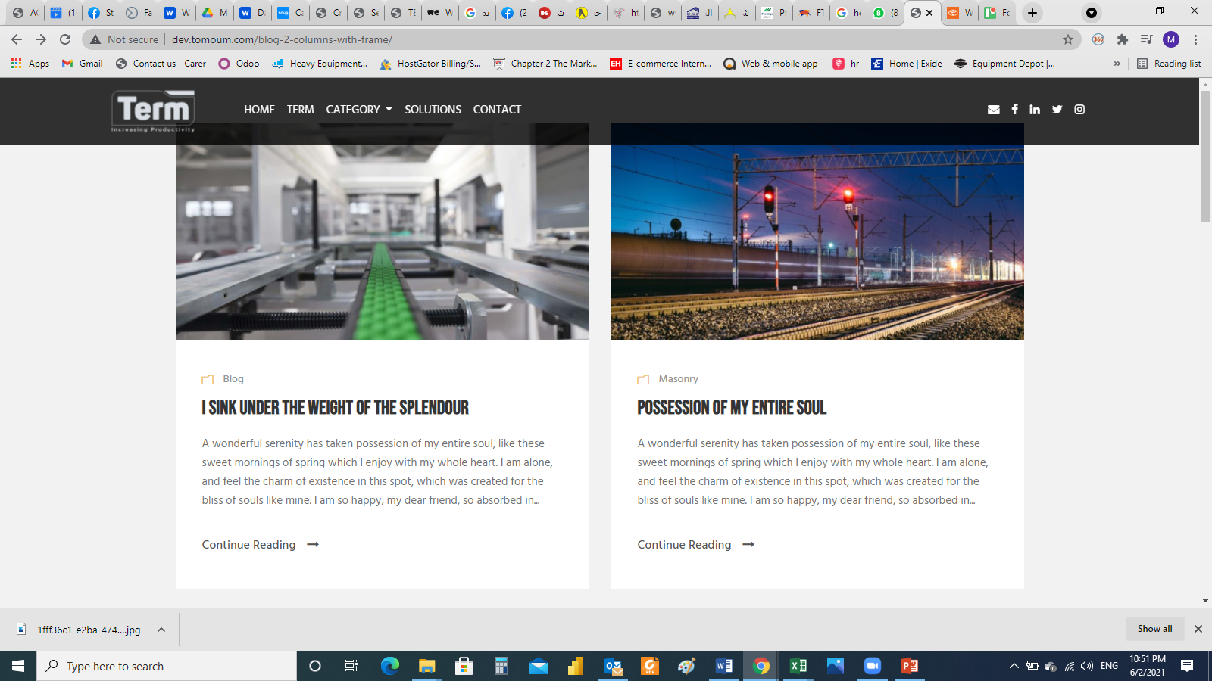
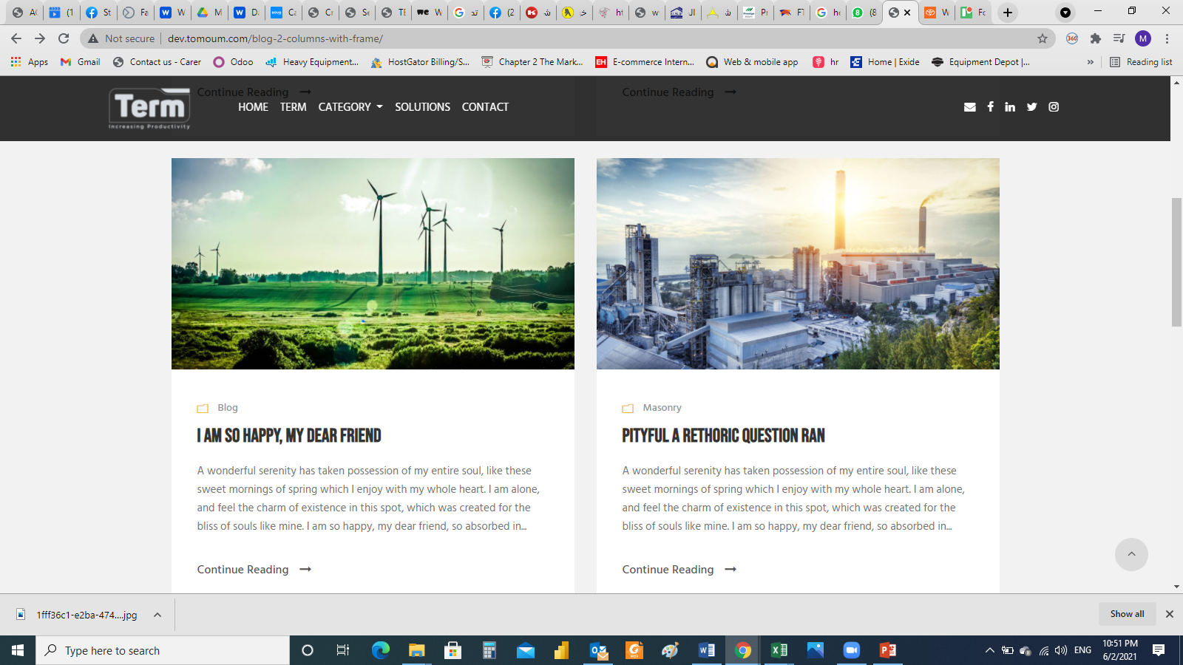
News and Resources
تغيير اسم الصفحة الحالية بدلا من solutions لتكون news and resources او الى اى اسم تانى يفيد المعنى
يمكن عمل 3 مربعات جنب بعض بدلا من مربعان
هدف الصفحة هو اضافة اى اخبار لدى الشركة او نصائح للمستخدمين عن المنتجات و خلافة
لاننى سوف اقوم بعمل share لهذا المحتوى على صفحة ال Facebook
Notes:
Forklift and material handling (Mitsubishi – Heli – Noblelift)
Electric vehicles (Citycart)
Power sports (Buggy – Segway)

